Slide 1
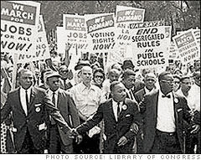
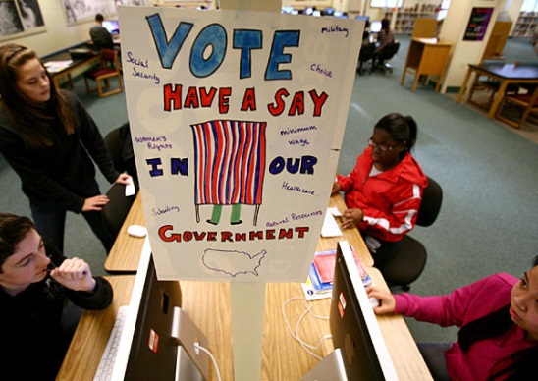


In your Interactive Notebook: Unit 2 - Lesson 10
Privacy & Individual Rights: Amendments 4,5,6, & 14
LESSON ESSENTIAL QUESTION:
How have the courts upheld the due process of law for individuals accused of a crime?
ESSENTIAL VOCABULARY for lesson:
Due Process, self incrimination, warrant, probable cause, reasonable suspicion, double jeopardy, trial by jury, speedy trial, eminent domain
4th amendment, Mapp v Ohio, Exclusionary rule, New Jersey v TLO
5th amendment, Miranda v Arizona
6th amendment, Gideon v Wainwright
14th amendment, equal protection clause
Warm Up (In google doc):
Police are not allowed to search anyone at any time for any reason. Why not? Doesn’t this make it easier for criminals to get away?

Slide 2
In your Interactive Notebook: Unit 2 - Lesson 10
Privacy & Individual Rights: Amendments 4,5,6, & 14
Lesson 10 Performance Task:
“Do I have a right” game in www.icivics.org
Class Website:
  www.mrggcivivcs.weebly.com
DEADLINES & HOMEWORK:
Test Corrections: By _______
Performance Task Deadlines:
  Lesson 6: Due Now!
  Lesson 8/9: Due now / late
  Lesson 10:
Vocab Quizzes
  Lessons 8-10 – end of today’s lesson
  Lesson 11/12 – covered on Unit Test
Unit 2 Test: COMPREHENSIVE:
  Friday, March 20th

Slide 3
Constitution requires Due Process
The government must use proper legal procedures before taking away a persons freedom or property
  Must have evidence of a crime before getting a warrant
    Evidence has to be gathered LEGALLY
  Must ensure that constitutional rights are provided to those accused of crimes
    4th, 5th, 6th, 8th amendments
  Everyone has a right to use the legal system
    7th amendment

Slide 4
Warrants & Probable Cause
When police are ready to make an arrest, they get a judge to sign a warrant.
  Police must have a warrant to arrest a person
UNLESS they have PROBABLE CAUSE
  Clear visual evidence that you did the crime
    Example: the cop saw johnny breaking into a car
    The cop saw Ricky trying to hide a laptop under his coat and walk out of the store

Slide 5
Due Process: Miranda Rights
Miranda v. Arizona
  Supreme Court case
  Police have to inform people they arrest of their rights to:
    Remain silent
      Because 5th amendment protects against “self-incrimination”
    Have an attorney even if you can’t afford one
      6th amendment

Slide 6
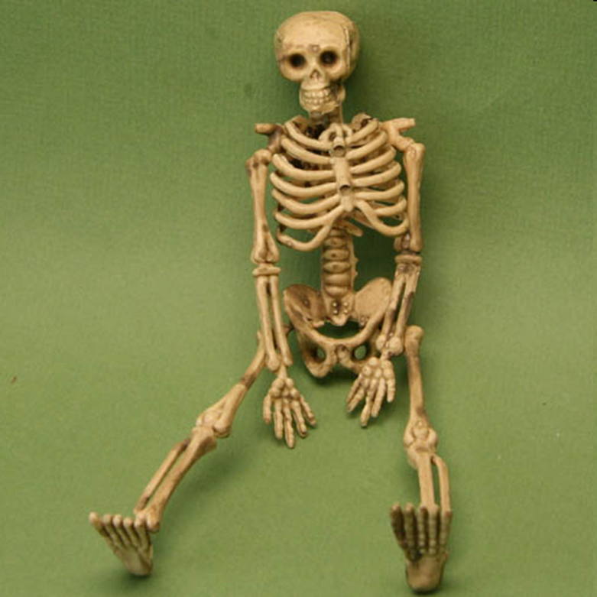
Habeas Corpus
Can’t be arrested without a reason
  Protected by 6th amendment

Slide 7
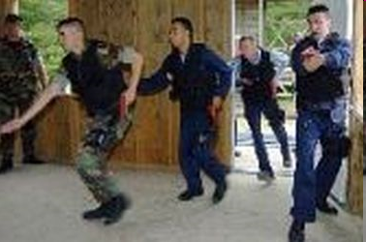
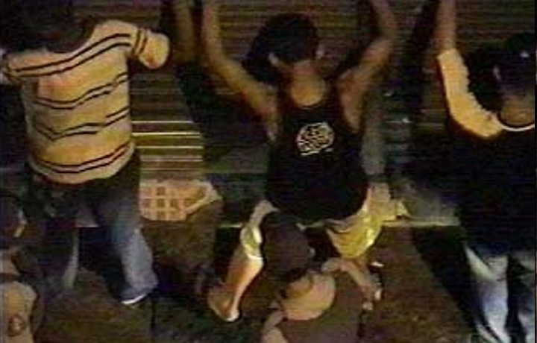
4th Amendment
Protection from unreasonable searches and seizures
  Can’t search you or take anything from you without a warrant or probable cause

Slide 8
But the CAN search without a warrant if…
You agree to the search
You are already being arrested legally and they find something as they arrest you
Probable cause – things that give officers a good reason to believe the person is involved in a crime
  Plain view – if officers see something while going about their business they can follow up on it
  Stop and frisk – officer must have “reasonable suspicion” of a criminal act
  Hot pursuit / emergencies – if officer is chasing a person or sees a person running from scene of a crime

Slide 9
When can they search you at school?
New Jersey v. TLO
  You have fewer 4th amendment protections at school then elsewhere because:
    Schools are public property
    Student safety is the primary concern
  Principals may search if they have REASONABLE SUSPICION, but…
    Search has to be limited to the specific thing they are looking for
    Cannot search without a reason unless ALL students are being screened

Slide 10
Due Process: Exclusionary Rule
Government cannot use evidence if the evidence was obtained illegally
  Mapp v. Ohio
  illegal searches make evidence “inadmissable”
    That means it cannot be used in court

Slide 11
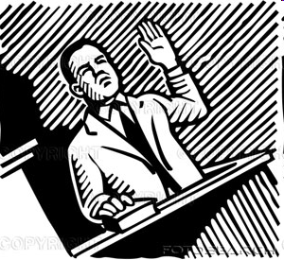
5th Amendment
Can’t force you to testify against yourself
  Miranda v. Arizona
No Double Jeopardy-Can’t try you twice for the same offense
Must receive due process—everyone gets the same treatment

Slide 12
Also the 5th Amendment
EMINENT DOMAIN
  Government cannot take private property for public use without fair compensation
  EXAMPLE:
    A new highway is being planned and will cut through a neighborhood
    Government has to pay the home owners for their homes and property before taking their land

Slide 13
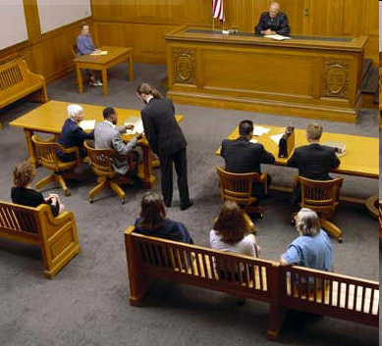
6th Amendment
Right to a speedy trial
Right to be told about what you are being charged with (HABEAS CORPUS)
Right to confront witnesses
Right to present your own witnesses
Trial by impartial jury
Right to a lawyer
  Gideon v. Wainwright

Slide 14
Due Process Scenarios
Read each scenario on your handout. Each one describes a violation of the constitutional right to due process. Fill in the chart with:
  The right that was violated
  The amendment that was violated
  Relevant Supreme Court cases

Slide 15
14th Amendment (1868)
Equal Protection clause – all people must be treated equally under the law
  You cannot discriminate based on race, sex, religious affiliation, etc.
  Extended protections of bill of rights to “all people”
  Courts have not always interpreted this the same way:
    Jim Crow Laws were legal for 85 years

Slide 16
14th Amendment Cases
Plessy v. Fergusson (1896)
  Supreme court rules that segregation is acceptable
  Created precedent of “separate but equal”
    Made Jim Crow system legal
Brown v. Board of Education (1954)
  Supreme Court overturned Plessy v. Fergusson
  Rules that separate cannot be equal
    Required the racial integration of public schools

Slide 17
Quick Write
How did the Supreme Court’s interpretation of the equal protection clause of the 14th amendment change between the Plessy v. Ferguson (1896) opinion and its opinion in Brown v. Board of Education (1954)?

Slide 18
Be a Constitutional Lawyer!
Log into your account on www.icivics.org
  Find the assignment called: “Do I have a right?”
    Play the game
YOUR GOAL:
  You are a lawyer setting up a law firm
  Clients come in thinking their rights were violated
  Figure out if they were, and if so, which amendment was violated. Match them up with lawyers that work for you that can help them

Slide 19
Review Strategy & Quiz
Create & review vocabulary terms.
Go to: dps.powerschool.com/public
  Log into powerschool.
  Select “schoolnet”
  Enter quiz code: CE2Q10

Slide 21

COMPELLED TO BE A WITNESS AGAINST HIMSELF
5th Amendment
What Does That Mean??

Slide 22
5th Amendment:
No person … shall be compelled in any criminal case to be a witness against himself…

Slide 23

1) A prisoner is being threatened by other prisoners because of a rumor that he killed a child. He is befriended by a prisoner who is a paid informant for the FBI. The informant offers to protect the prisoner if the prisoner tells him whether the rumor is true. The prisoner admits to the murder.

Slide 24
Did the “friend’s” offer of protection compel the suspect to be a witness against himself under the 5th Amendment?

Slide 25
YES!
The only reason the prisoner confessed was because he was afraid that, without protection from his friend, other prisoners would hurt him. The Court said a threat of physical violence is enough to cause a statement to be compelled. There does not have to be actual physical violence.
Arizona v. Fulminante (1991)

Slide 26


2) Three police officers drive a robbery suspect to the police station. The officers have not yet found the gun used in the robbery. On the way to the station, one officer mentions to another officer that there is a school for handicapped children nearby. He says it would be terrible if one of the school children finds the gun and hurts themselves. Hearing this, the suspect tells the officers where the gun is.

Slide 27
Did mentioning the danger to handicapped children compel the suspect to be a witness against himself under the 5th Amendment?

Slide 28
NO!
The Court said the suspect was not compelled to confess. First, the officers were talking to each other, not to the suspect. More importantly, although the officers may have hoped the suspect would react to what they were saying, they had no reason to believe the suspect would care whether children got hurt.
Rhode Island v. Innis (1980)

Slide 29
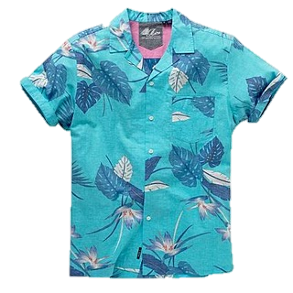
4) Investigators trying to solve a murder want to know whether a certain shirt belongs to the suspect. They make the suspect try the shirt on despite his objection, and the shirt fits him. This evidence is used in a trial to help convict him.

Slide 30
Did making him try on the shirt compel the suspect to be a witness against himself under the 5th Amendment?

Slide 31
NO!
The Court said being a witness against yourself only applies to communication. When he was forced to put on the shirt, he was not forced to communicate anything. If the 5th Amendment could stop this, then it could also stop the jury from looking at the suspect and comparing him to a photograph of someone.
Holt v. U.S. (1910)

Slide 32

6) A man is arrested at a hospital after a car accident. The officer believes the man has been drinking and driving. He orders a doctor to take a blood sample even though the man protests. The sample shows alcohol in the man’s blood.

Slide 33
Did forcing the suspect to give a blood sample compel him to be a witness against himself under the 5th Amendment?

Slide 34
NO!
When the officer told the doctor to take the blood sample even after the suspect protested, the suspect was compelled to give blood. However, the Court said being a “witness” against yourself only applies to communication. The suspect was compelled to give physical evidence. He was not compelled to communicate anything.
Schmerber v. California (1966)

Slide 35
MINI-QUIZ
5th Amendment
True or False?

Slide 36
True or False?
1) “Compelled” means “forced.”
The 5th Amendment prohibits forcing suspects to communicate evidence against themselves.
✓
True
False

Slide 37
True or False?
2) With the 5th Amendment, the Court is worried about police wrongdoing that forces a confession.
✓
The Court has talked about the intimidating environment and tactics used during police interrogation.
True
False

Slide 38
True or False?
4) Being a “witness” against yourself only applies to communicating information.
✓
True
False
The Court has said trying on a shirt, for example, is not communication.

Slide 39
True or False?
5) Suspects are completely protected because police can’t make them be a witness against themselves.
True
False
There are some things police can make suspects do that aren’t considered communication.
✓

Slide 40
True or False?
6) The Court doesn’t care how police get a confession as long as the criminal is caught.
True
False
✓
That’s the whole point of the 5th Amendment!

Slide 41
True or False?
7) The main consequence of violating the 5th Amendment is not being able to use the evidence against the suspect.
✓
Evidence obtained by compelling someone to be a witness against themself can’t be used to convict the person of the crime.
True
False

Slide 42
True or False?
8) People suspected of a crime have the right to remain silent.
✓
The Court has put protections in place to safeguard this right. Police must read suspects their rights.
True
False

Slide 43
Review Strategy & Quiz
Create & review vocabulary terms.
Go to: dps.powerschool.com/public
  Log into powerschool.
  Select “schoolnet”
  Enter quiz code: CE2Q10

